Slide 1

Fake News Detection in OSM (Reddit analyzer)
St. Francis Institute of Technology
Department of Computer Engineering
Group Members
Delisha Naik(20)
Deep Patel(25)
Soham Patil(28)
Soham Ponkshe(32)
Guide Name:-Ms. Dakshata Panchal
.
Guide: Ms. Snehal Kulkarni
Notes:
‹#›

Slide 2

Content
Introduction
Problem Definition
Review of Literature
Proposed Model/Solution
Block Diagram/Architecture of Model
Hardware & software requirements
Social Impact of the System
Implementation Details(Algorithm used, snapshots of the output)
Conclusion
References
‹#›
Fake News Detection in OSM
*
Notes:
‹#›

Slide 3
Introduction
Digital media has transformed the way we consume and share information. News spreads within seconds across social platforms, reaching millions instantly. While this enables quick access to updates, it also increases the risk of misinformation. Understanding how information flows in the digital age is essential for staying well-informed.
In today’s fast-paced digital world, staying updated with accurate news is crucial. With the rise of social media, misinformation spreads rapidly, influencing public opinion and decision-making. Fake news can create confusion, fuel misinformation, and even lead to serious consequences. Therefore, having reliable tools to detect and verify news sources is essential for ensuring trustworthy information.
‹#›
Fake News Detection in OSM
*
Notes:
‹#›

Slide 4
Problem Definition
Misinformation on social media platforms poses significant risks, affecting various aspects of society.
False news about emergencies or health crises can cause widespread panic, while political propaganda manipulates public opinion and influences elections.
Misinformation in healthcare leads to harmful decisions, and financial scams result in monetary losses.
Social unrest can arise from fake news promoting hate speech and discrimination, further eroding trust in legitimate institutions.
Businesses and individuals may suffer reputational damage due to false allegations, sometimes leading to legal consequences.
‹#›
Fake News Detection in OSM
*
Notes:
‹#›

Slide 5
Review of Literature
Sr No. Title of Paper Year of Publication System Description (Findings) Disadvantages/ Paucity 2021 CharacteCharacterization, Classification and Detection of Fake News in Online Social Media Networksrization, Classification and Detection of Fake News in Online Social Media Networks The proposed solution consists of two main components: a stance detection model and a fabricated content classifier. It's possible that achieving high accuracy comes at the cost of speed, which could be a disadvantage in real-time applications. 2. 2022 A novel approach to fake news detection in social networks using genetic algorithm applying machine learning classifiers The paper proposes a new approach using a genetic algorithm (GA) for fake news detection, SVM and LR classifiers both achieved 61% accuracy in the LIAR dataset, and SVM and RF attained the highest accuracy of 97% in the fake job posting dataset The relatively low accuracy of the SVM classifier (61%) on the LIAR dataset highlights a significant limitation of using this classifier on certain types of fake news data.
‹#›
Fake News Detection in OSM
*
Notes:
‹#›

Slide 6
Proposed Model/Solution
The proposed solution is a Streamlit-based web application that analyzes Reddit posts using a Random Forest classifier trained on various features including text sentiment, domain credibility, user metrics, and content characteristics. The system fetches real-time data from Reddit using the PRAW API, extracts meaningful features from posts and comments, and generates credibility scores with confidence levels for each analyzed post.
The model incorporates both content-based features (such as text complexity, sentiment analysis, and clickbait detection) and contextual features (including user account age, karma scores, and community engagement patterns). This multi-faceted approach provides a comprehensive credibility assessment framework that can adapt to different subreddits and content types while maintaining transparency by explaining the factors influencing each prediction.
‹#›
Fake News Detection in OSM
*
Notes:
‹#›

Slide 7
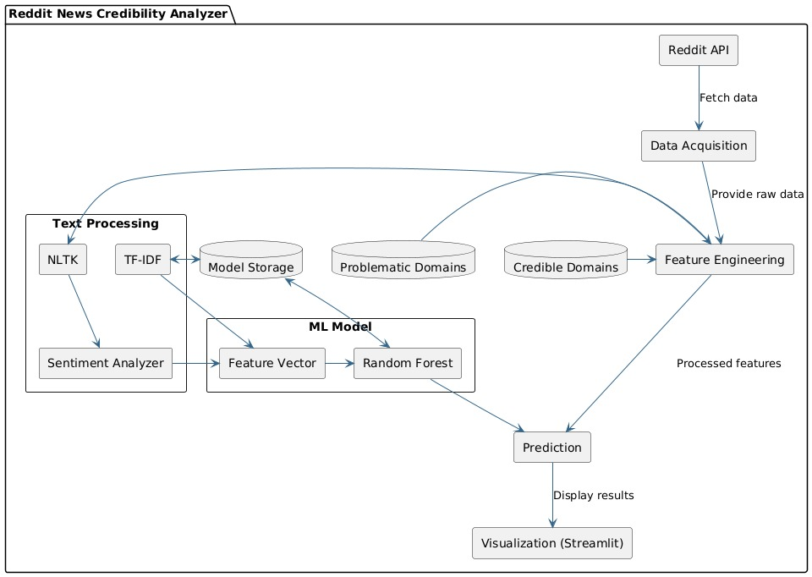
Block Diagram
‹#›
Fake News Detection in OSM
*
Notes:
‹#›

Slide 8
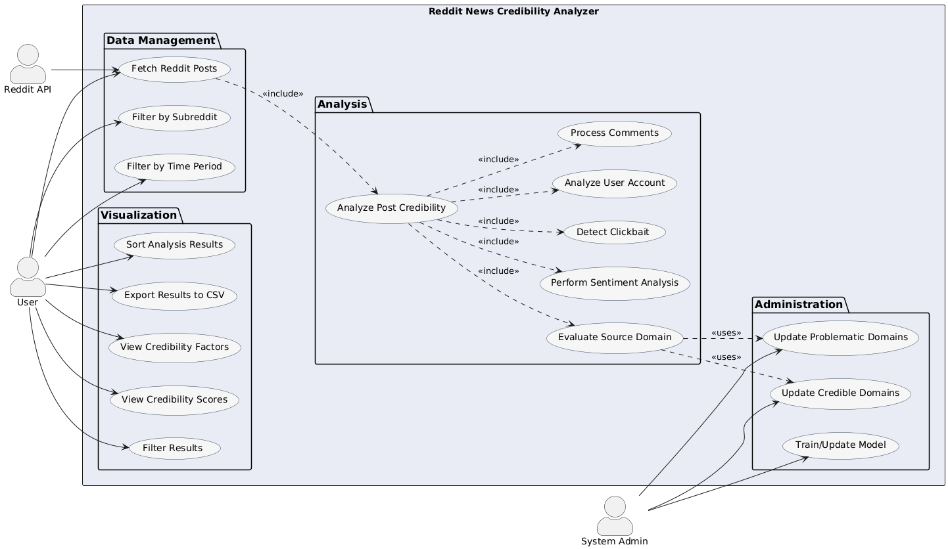
Use Case Diagram
‹#›
Fake News Detection in OSM
*

Slide 9
Hardware and Software Requirements
The application requires a standard computer with internet connectivity and sufficient processing power to handle machine learning operations. Minimal hardware specifications include a multi-core processor, at least 4GB of RAM, and adequate storage for model storage and data processing.
The software stack includes Python 3.7+, Streamlit for the web interface, PRAW for Reddit API interaction, scikit-learn for machine learning functionality, NLTK for natural language processing, and pandas for data manipulation. Additional dependencies include numpy for numerical operations, joblib for model persistence, and datetime for timestamp processing.
‹#›
Fake News Detection on OSM
*
Notes:
‹#›

Slide 10
Social Impact of the System
The Reddit News Credibility Analyzer addresses the critical social challenge of misinformation by empowering users to make more informed decisions about the content they consume and share. By providing transparent assessments of news credibility, the system promotes media literacy and critical thinking skills among social media users.
The tool has potential benefits for educators, journalists, researchers, and everyday users seeking to navigate the complex information landscape. By highlighting factors that influence credibility, the system also creates opportunities for content creators and platforms to improve their practices and develop more responsible content sharing mechanisms.
‹#›
Fake News Detection in OSM
*
Notes:
‹#›

Slide 11
Implementation Steps
The implementation process follows these key steps:
Set up environment with Python libraries (Streamlit, PRAW, scikit-learn, NLTK, pandas).
Configure Reddit API connection using PRAW with proper credentials.
Build model training pipeline with feature engineering and Random Forest classifier
Develop Streamlit UI with search filters and visualization components.
Populate domain databases of credible and problematic sources.
Implement data processing pipeline for Reddit posts.
Test and validate system accuracy.
Deploy to a suitable Python web app hosting platform.
Create user documentation explaining features and methodology.
‹#›
Fake News Detection in OSM
*
Notes:
‹#›

Slide 12
Conclusion
The Reddit News Credibility Analyzer represents a significant step forward in combating misinformation on social media platforms through automated credibility assessment. The system successfully demonstrates the feasibility of using machine learning and natural language processing techniques to evaluate news content based on multiple credibility indicators.
Future enhancements could include expanding the model to analyze images and videos, incorporating fact-checking APIs, and developing browser extensions for seamless integration with the Reddit browsing experience. As misinformation continues to evolve, such tools will play an increasingly vital role in promoting a healthier information ecosystem online.
‹#›
Fake News Detection in OSM
*

Slide 13
REFERENCES
‹#›
Fake News Detection in OSM
*

